Slide 1



Protein interactions and binding site properties
Allegra Via

Slide 2
Shared notes: http://bit.ly/PPI-2020-notes

Slide 3
Introduction to Protein-ligand interactions
Principles of protein interactions and binding site properties
Tools to study molecular aspects of PPI
Protein-protein docking
General principles (lecture)
ClusPro
ClusPro results analysis
Protein-protein interaction networks
Resources (databases) to study PPI
Principles of graph theory and networks
Studying PPI with Cytoscape
Protein-small molecule interactions
Drugs and drug targets
Principles of drug design, drug target prediction and drug repositioning
Resources (databases) and tools to study protein-small molecule interactions

Slide 4
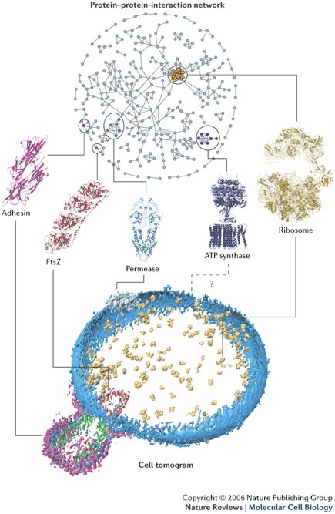
Reductionist biology – molecular viewpoint
Specific molecule(s) of interest
Experiments to determine interaction partners and modes of interaction
Prediction of interaction partners and modes of interaction
Analysis of specific interaction

Slide 5
Protein networks
Identification of functional modules (set of proteins highly connected to each other)
Hubs, singletons
Networks' analysis -> biological hypotheses
Prediction of new interactions
Reductionist biology – molecular viewpoint
Specific molecule(s) of interest
Experiments to determine interaction partners and modes of interaction
Prediction of interaction partners and modes of interaction
Analysis of specific interaction

Slide 6
Protein networks
Identification of functional modules (set of proteins highly connected to each other)
Hubs, singletons
Networks' analysis -> biological hypotheses
Prediction of new interactions
Reductionist biology – molecular viewpoint
Specific molecule(s) of interest
Experiments to determine interaction partners and modes of interaction
Prediction of interaction partners and modes of interaction
Analysis of specific interaction
Systems biology
Networks, pathways implicated in a condition
Identify perturbed or deregulated systems
Modelling of the system to infer to signals and/or deregulation events
Experiments to determine responses of the system

Slide 7
Protein-ligand interactions
Protein functions are based on the capability of proteins to bind a certain ligand (or more)
elemental ions
small organic molecules (~600 Da or less)
peptides
macromolecules

Slide 8
A few definitions
Binary interaction
Protein complex
Homo vs hetero
Stable vs transient
Protein binding interface
Protein networks, hubs
Interactome

Slide 9
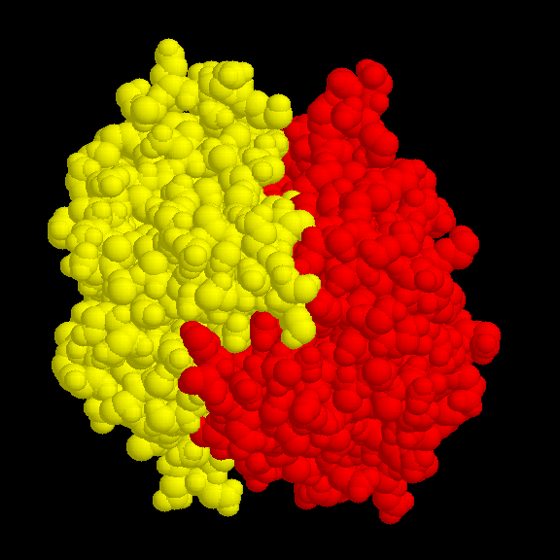
Binary interactions

Slide 10
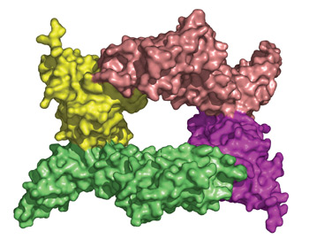
Protein complex
A structural image of the protein-protein complex formed when Yersinia pestis YpkA (green and pink) binds to the Rac1 protein of the host cell (yellow and purple)

Slide 11
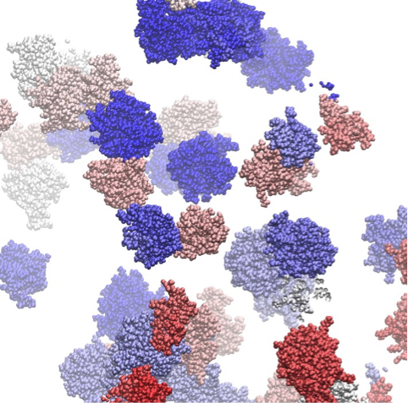
Protein interaction interfaces
Molecular dynamics simulation snapshot of a colicin E9 and Im9 protein solution (van der Waals presentation and individual colors for each protein) indicating multiple transient association events
Copyright: © Technische Universität München, Physik-Department T38
http://www.gauss-centre.eu/gauss-centre/EN/Projects/LifeSciences/2014/zacharias_crowded_enviroment.html?nn=1361034

Slide 12
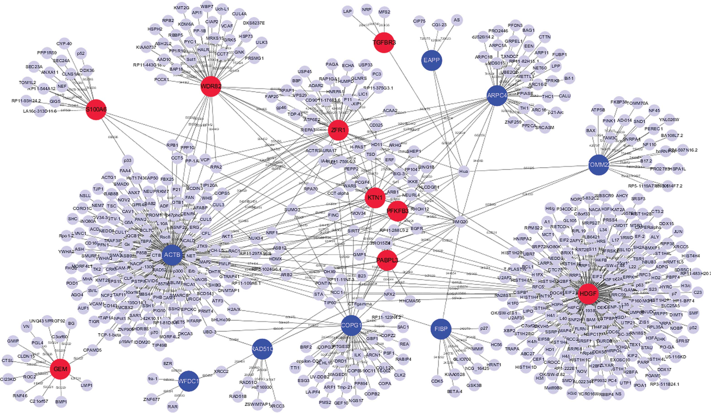
Protein interaction network - hubs

Slide 13
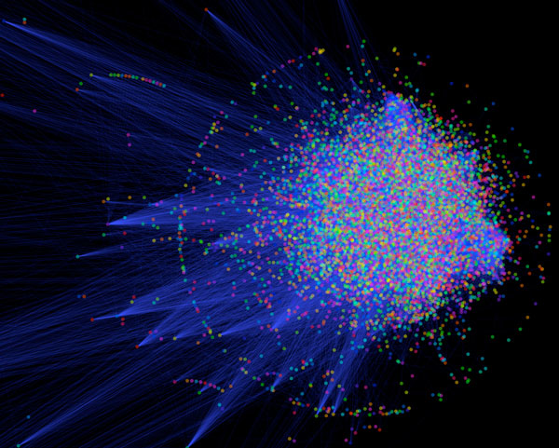
In an organism, PPIs form a huge complex network known as an “interactome”
Nearly 650,000 interactions regulate human life
Any deregulation leads to a disease state or death

Slide 14
PPIs are at the basis of key cellular processes
Signal transduction/communication
Enzyme-mediated catalysis
Immune response
Cellular division
Programmed cell death
Cell-cell recognition
Viral action
Metabolic and genetic regulatory networks

Slide 15
Roles of ligands
Catalysis: substrate, products, cofactors
Regulation: ATP, hormones, etc.
Communication pathways: first or second messengers, downstream regulators
Protein trafficking: ligands serving as means by which organelles or other macromolecules are recognised by proteins
Prosthetic groups: heme group
Defense/offense: toxins

Slide 16
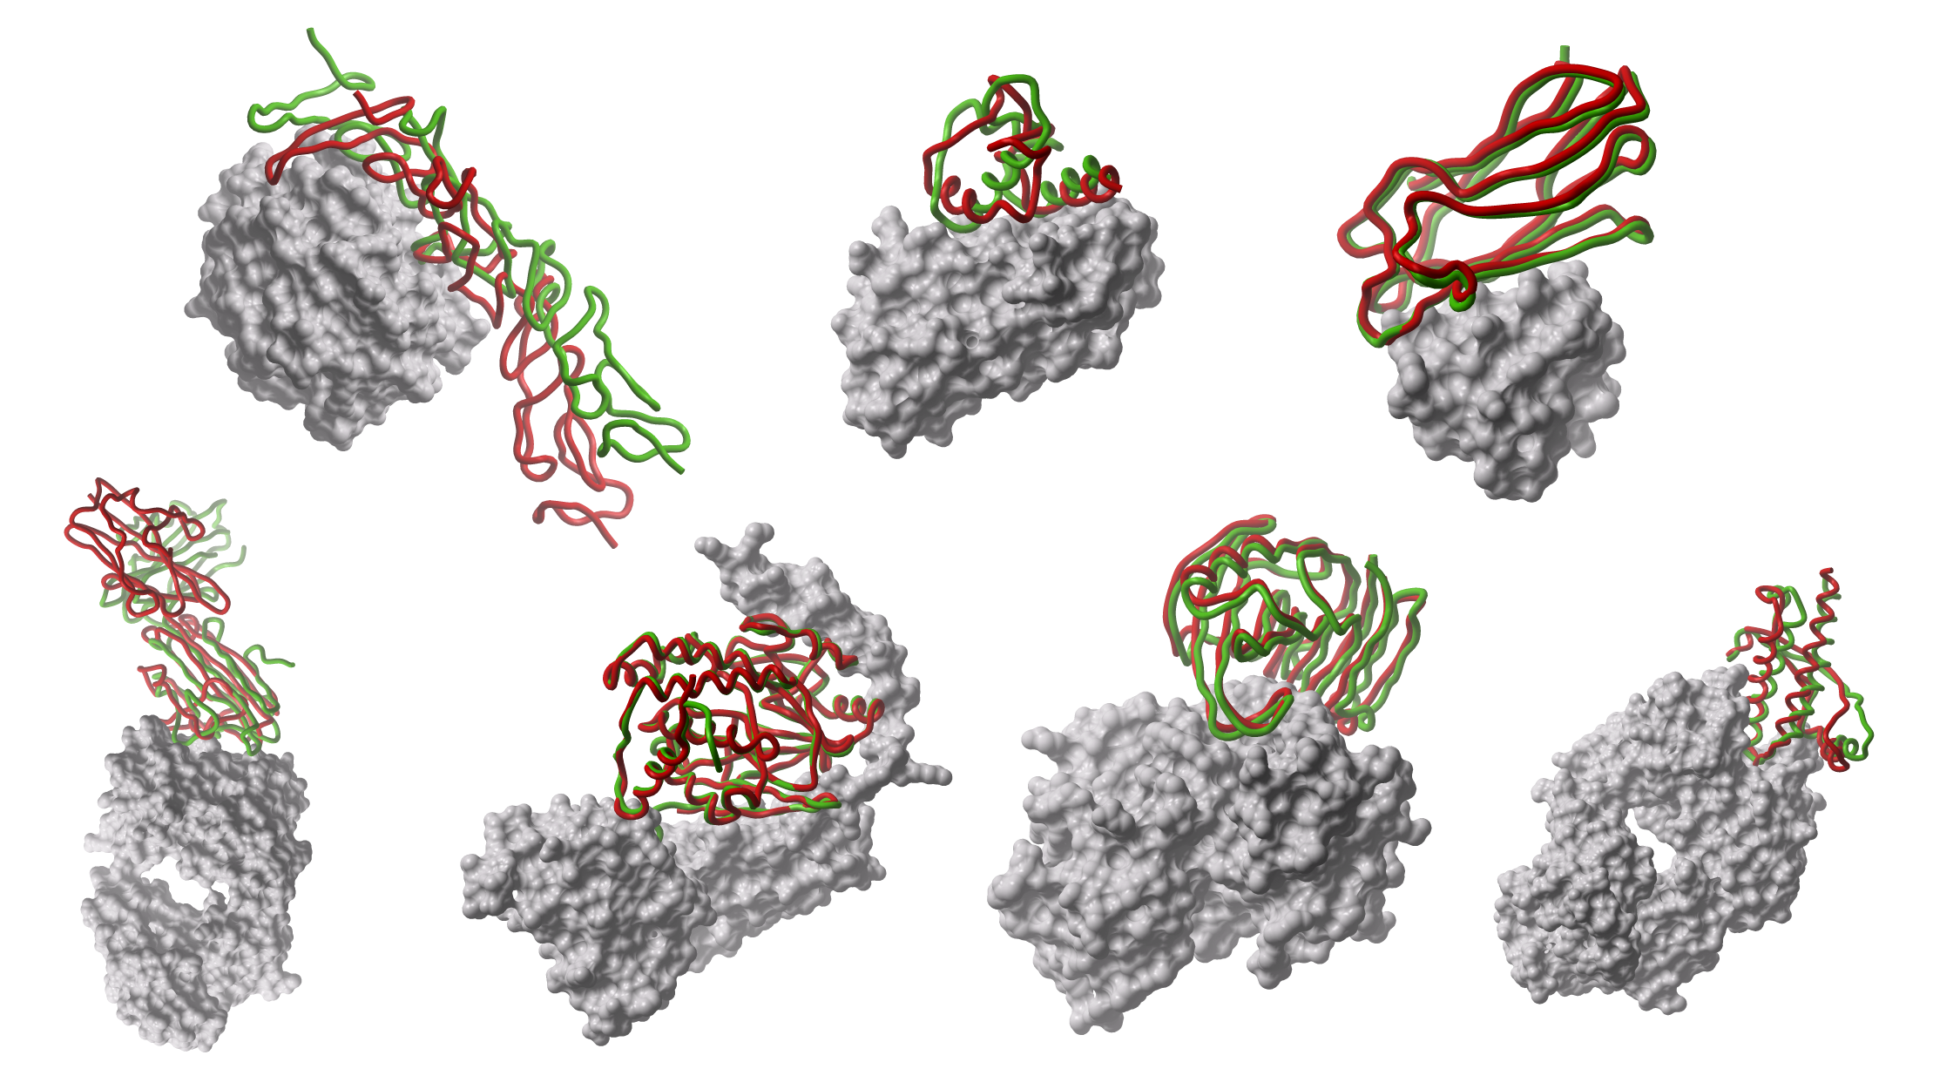
The reductionist approach

Slide 17
We can classify PPIs according to:
Biological context: enzyme-substrate, antibody-antigen, receptor-hormone/neurotransmitter
Permanence of binding: permanent-obligate vs transient
Similarity of the binding partners: homo vs hetero
Number of binding partners: hub, non-hub
Some of the above categories may partially overlap

Slide 18
Strong transient: This category includes interactions that are triggered/stabilised by an effector molecule or conformational change. An example is given by the Ras proteins, which form tight complexes with their partners when GTP-bound and only weak complexes when GDP-bound.
Perkins et al, Structure, 2010

Slide 19
Transient vs Stable
Transient (relatively weak)
Brief and reversible interactions occurring in specific cellular contexts
Stable (for a longer period of time)
Proteins take part of permanent complexes as subunits, in order to carry out structural or functional roles
Vocabulary: permanent, obligate, oligomeric, tight, more stable

Slide 20
Examples
Transient interactions
Interactions mediated by short linear motifs
Interactions mediated by PTMs
Disorder-to-order transitions
Proteins involved in signalling cascades
Stable interactions
Homo-oligomeric or hetero-oligomeric complexes
Interactions mediated by PTMs
enzyme-inhibitor
antibody-antigen
domain-domain
domain-peptide
Perkins et al, Structure, 2010

Slide 21
Protein-ligand interfaces Structure-function relationship
The ability of proteins to form biologically active complexes depends on the properties of their binding surfaces:
Size
Geometric compatibility
Chemical composition
Polarity
Atom packing efficiency
Hydrogen bond or salt bridge frequency
Number of buried water molecules
Interaction energy
Residue conservation
Types of secondary structures

Slide 22
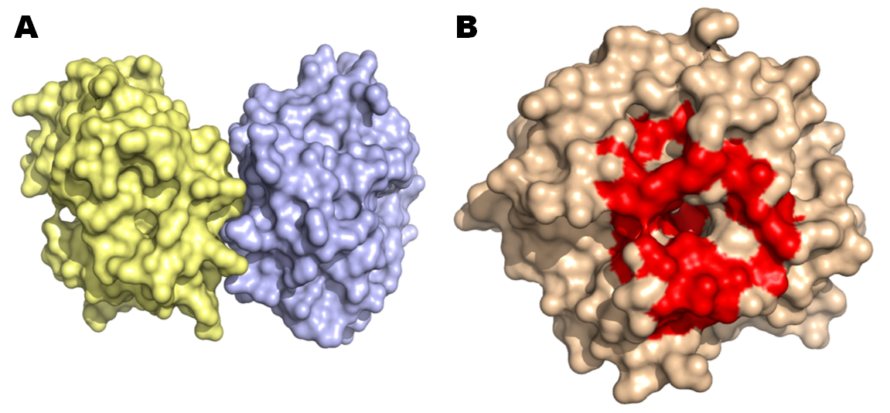
A. Hpx14 homodimer (PDB 3C7X) B. Definition of the docking site (red patch)

Slide 23
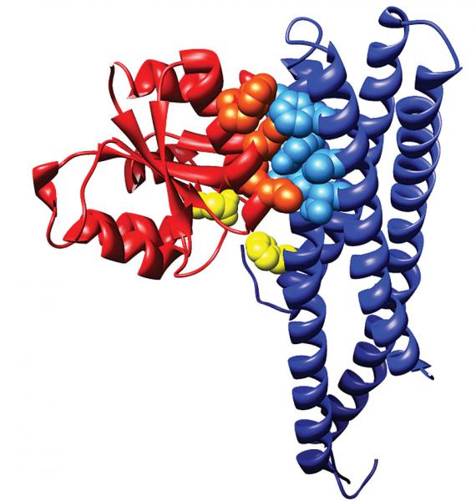
membrane-bound sensor histidine kinase
response regulator
. The catalytic residues that exchange a phosphoryl group are shown in yellow (courtesy of Alexander Schug and Hendrik Szurmant)

Slide 24
Check-point I
Go to the GDoc
Write your name
After your name, write a summary of the lecture, namely all you remember from the lecture.
You have access to the presentation, which means you can go through the slides to better remember and organise your text

Slide 25
What is the protein-ligand interaction driving force?

Slide 26
Energy and work are necessary to keep order
The entropy of the universe tends to grow
The formation of macromolecules is not an accidental
process but requires work
The synthesis of macromolecules needs energy
We measure the energy variations occurring during chemical reactions in terms of GIBBS FREE ENERGY, G.

Slide 27
Work and energy are necessary to keep order
G represents the “usable” energy of a system, i.e. the energy available to carry out work
G = H - TS
In particular, G is the thermodynamic quantity that can be used to determine the direction of a process

Slide 28
How?
The thermodynamic quantity used to determine the direction of a process is the Gibbs free energy G
Gibbs free energy is a state variable: it depends on the initial and final equilibrium states and not on the way in which the system acquired that states.
To decipher the direction of a process, we can look at its initial and final state, i.e. evaluate the free energy variation:
ΔG

Slide 29
G = H - TS
Biological systems are not isolated: they exist in a state of constant pressure and temperature
The free energy variation can be written in terms of enthalpy (H) and entropy (S) change at constant temperature.
ΔG = ΔH - TΔS
ΔH = Enthalpy variation. It represents the heat released or absorbed by the system in a reaction.
ΔS = Entropy variation. It represents the general tendency of a system to maximise its disorder.

Slide 30
Enthalpy H
Quantity of energy that a system can exchange with the environment
H = E + PV
Internal energy
of the system
pressure
volume
Biological systems are either solid or liquid. Therefore they do not usually undergo volume or pressure changes.
Biological systems are not isolated: they exist in a state of constant temperature and pressure.
ΔH ≈ ΔE

Slide 31
Internal energy E
E = U + K
Potential energy
Kinetic energy
Position energy: in a macromolecule the potential energy is the result of all field (electrostatic) effects of the atoms of the molecular system
It is the result of the molecular motions induced by the heat
Set of covalent and non-covalent interactions in a molecular system.

Slide 32
ΔG = ΔH - TΔS
covalent bond breaking or making
Variation in the electrostatic or van der Waals interactions
Variations induced by the heat in the atomic motions
These variations at constant pressure entail heat transfer between the system and the environment. Therefore, we can write:
Q_{(p)} = ΔH ≈ ΔE
Therefore, at constant pressure and volume, the enthalpy variation coincides with both the heat and the variation of internal energy occurred during the process.
Q_{(p)} can be experimentally measured
ΔH > 0 in a reaction adsorbing heat
Conventionally
ΔH < 0 in a reaction releasing heat

Slide 33
Energy is released to make bonds. The enthalpy change is negative because the system is releasing energy when forming bond.
Energy is required to break bonds. The enthalpy change for breaking bonds is positive.
ΔH < 0
ΔH > 0

Slide 34
The variation of free energy can be written in terms of enthalpy (H) and entropy (S) changes at a constant temperature
ΔG = ΔH - TΔS
ΔH > 0 mainly corresponds to the rupture of favourable non-covalent bonds
Enthalpy: amount of energy that a system can exchange with the environment
H = E + PV => ΔH ≈ ΔE
Formation or breaking of covalent bonds
Variations in the electrostatic or van der Waals interactions
Thermally induced changes in the atomic motions
ΔH = Change in enthalpy. It represents the general tendency to minimise the energy
ΔS = Entropy change. It represents the general tendency to maximise disorder

Slide 35
Entropy S
S = k_{B} lnω
ω = number of possible configurations of the system (microstates)
The number of possible states is inversely proportional to the system order
In classic thermodynamics, at constant temperature, entropy and enthalpy fulfill the following relation:
ΔH
Q_{(p)}
ΔS = =
T
T

Slide 36
Changes of G determine the direction of a process:
ΔG = 0 at the equilibrium
ΔG > 0 endergonic processes (requiring energy)
ΔG < 0 exergonic processes (releasing energy)
Spontaneous processes decrease their free energy

Slide 37
What happens in protein folding?
In the process of folding of a polypeptide chain the increase in entropy of the solvent compensates the loss of entropy of the macromolecule, leading to a general increase in entropy of the system as a whole.
ΔG_{folding} = ΔH - TΔS
ΔH < 0 (formation of the electrostatic or van der Waals interactions )
TΔS_{conformational} < 0
TΔS_{hydrophobic effect}> 0

Slide 38
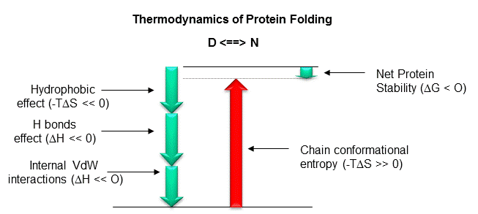

Slide 39
The driving force behind many events within the cell is represented by the increase in entropy generated in the water molecules when a reaction occurs

Slide 40
Entropy S
The number of possible states is inversely related to the order in the system. A highly ordered system can only access a few states while a disordered system can sample many
In the binding to a protein, the atoms of a ligand gradually become more confined and the entropy decreases.
However, the binding can occur thanks to the hydrophobic effect, which is accompanied by an increase in entropy of the solvent.

Slide 41
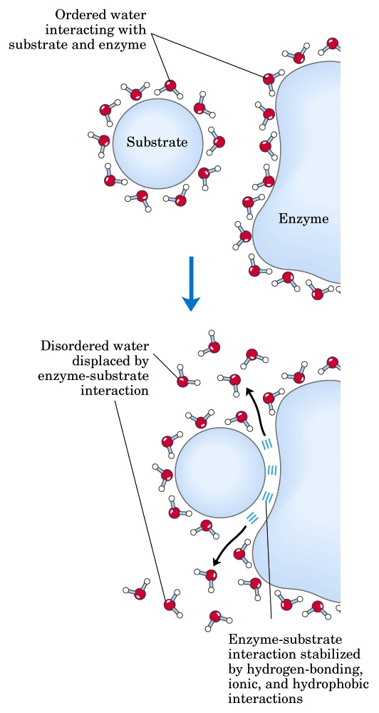
ΔG = ΔH - TΔS
Ligand binding is driven by the hydrophobic effect and van der Waals interactions, whereas electrostatic interactions make them specific
PPI interfaces tend to be more hydrophobic than surfaces that do not participate in the binding
Studies on enzymes demonstrate the importance of the hydrophobic effect also in binding non-protein substrates

Slide 42
Forces governing biomolecular recognition
Van der Waals
Electrostatics
Hydrophobic contacts
Hydrogen bonds
Salt bridges
All interactions act at short range → surface complementarity is needed for tight binding
Efrat Mashiach, http://bioinfo3d.cs.tau.ac.il/

Slide 43
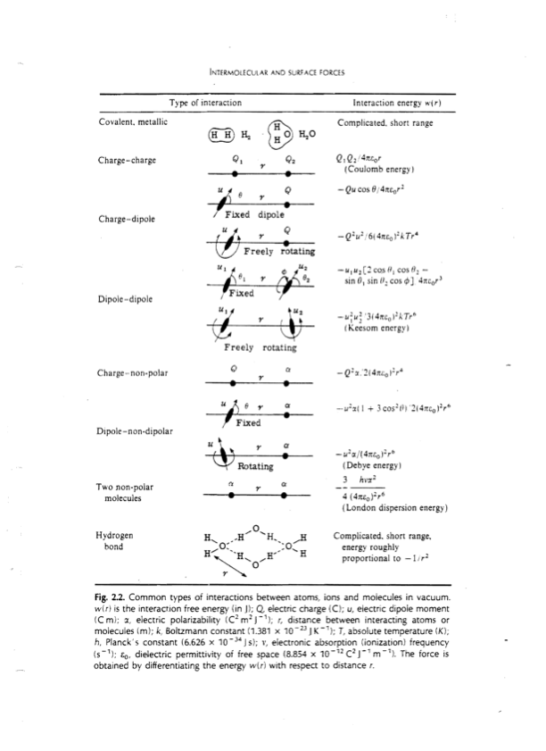

Slide 44
The Binding Site (BS)
Geometry alone is insufficient to recognise the correct ligand
The binding site-ligand match is based on: geometry and electrostatics
Geometric and electrostatic complementarity can be achieved using different BS architectures

Slide 45
Geometric complementarity
The geometrical match optimises all non-covalent interactions that mediate the binding
Short range and Van der Waals

Slide 46
Electrostatic complementarity
When ligand carries an electric charge → The BS tends to contain the opposite charge
Electrostatic match increases binding specificity

Slide 47
PPI surface size
The area of PPI interfaces is large (1000 to 4000 Å²)
Standard-sized interfaces are 1200 to 2000 Å²
Short-lived and low-stability complexes -> smaller interfaces (1150–1200 Å²)
Protein-small molecule interaction surfaces have a smaller area (300 - 1000 Å²).

Slide 48
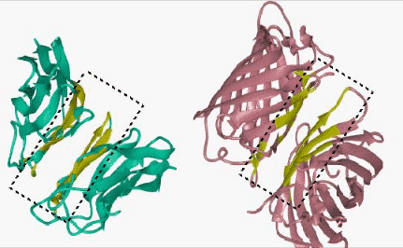
http://home.ku.edu.tr/~okeskin/INTERFACE/INTERFACES.html

Slide 49
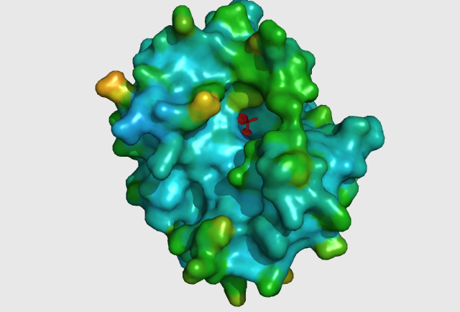
Protein-small molecule: small and deep depressions

Slide 50
Other PPI surface features
Flatter than that of other protein-ligand interfaces
Lack the grooves and pockets observed at the surfaces binding small molecules
Generally hydrophobic
Tighter atom packing
Lower polarity
Higher conservation (especially at the center of the interface)

Slide 51
Some more facts about PPIs
Transient interfaces differ from stable interfaces
Stable interfaces: less planar, more hydrophobic, better geometric and electrostatic complementarity
Homodimeric interfaces resemble protein cores
Heterodimeric interfaces are more like regular (i.e. non-binding) surfaces

Slide 52
Specificity
Conferred by electrostatic interactions
Electrostatic interactions prevent aggregation (mediated by non-polar interactions)

Slide 53
Affinity
The affinity of PPI varies from millimolar to picomolar, depending on the type of interaction and signaling needed (Chen et al. Protein Sci. 2013)
Despite affinity varies over a wide range, proteins can maintain a high degree of specificity for their partners

Slide 54
Specificity
Fixed scaffold, change of loop structure (antibodies)
Many proteins exhibit affinity for multiple partners (Reichmann et al. Curr. Opin. Struct. Biol. 2007) → hubs
The ability to bind different partners → Low specificity
Different proteins can bind the same interface, each interacting with a different cluster of nonpolar residues OR
To the same highly flexible interface

Slide 55
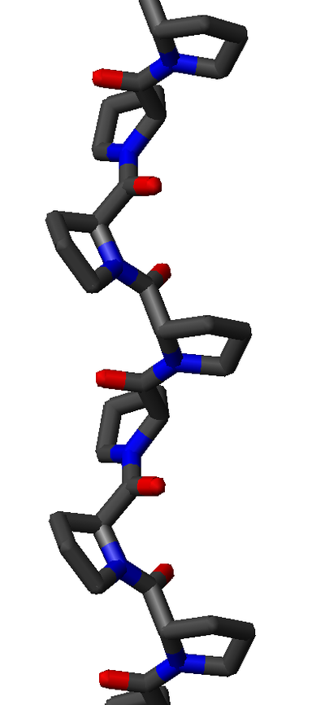
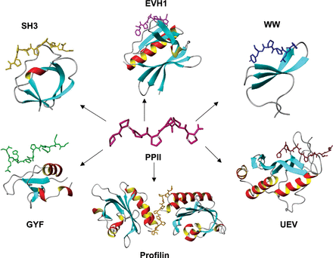
Polyproline type II helices

Slide 56
Protein-ligand binding energetics Protein-ligand affinities
Binding energies may range from -2.5 to -22 kcal/mol
Signal transduction networks -> weak interactions
Cofactor binding by enzymes (reversible but strong) -> -5.5 to -9.5 kcal/mol
Antibody-antigen: -8±3 kcal/mol
Receptor-hormone: -12 kcal/mol
Enzyme-inhibitor: -12±3 kcal/mol
Enzyme-transition state: -22±5 kcal/mol
Kuntz et al., 1999; Zhang&Houk, 2005

Slide 57
Hot spots
The protein-protein binding interface is heterogeneous
Only certain hydrophobic spots contribute to the free energy of binding and help to hold the two proteins together
Affinity seems to result from a small number of residues
Such residues are called hot spots
Hot spots are defined as residues whose replacement by alanine leads to an affinity/free energy change of at least 2 kcal/mol

Slide 58
Some fact about hot spots
Hot spots account for less than 50% of the contact area of PPI
Hot spots tend to be evolutionary conserved
Hot spots tend to appear as clusters in the interface
Some residues are found more frequently in hot spots (e.g., Phe, Tyr, Trp)
Hot spots are surrounded by energetically less important residues that probably separate/prevent bulk water from hot spots

Slide 59
Molecular structure of stable interactions (complexes): what information?
identification of interface residues/hot spots
details about the interface (solvent accessible surface area, shape, complementarity between surfaces, residue interface propensities, hydrophobicity, segmentation and secondary structure, and conformational changes on complex formation)
assignment of protein function
recognition of specific residue motifs

Slide 60
How PPI surfaces can be studied?
Experimental:
The most significant contribution to understanding the PPI surface comes from structural biology via X-ray crystallography or NMR as well as mutational studies
Computational:
Prediction of interaction/binding sites
Prediction of protein-protein complexes
In silico mutational studies

Slide 61
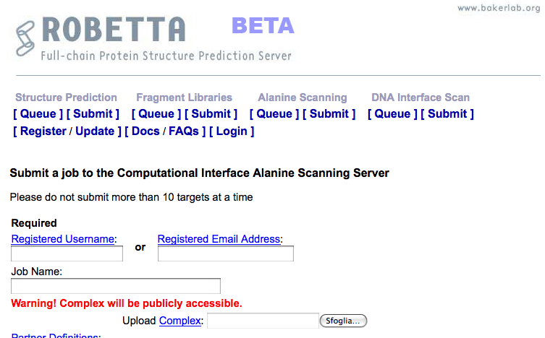
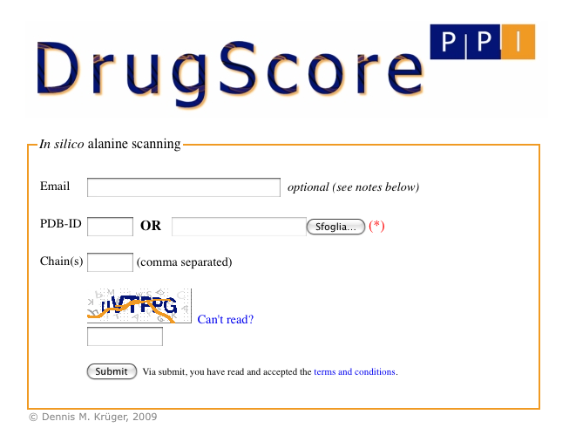
Computational alanine-scanning in protein-protein interfaces
http://robetta.bakerlab.org/alascansubmit.jsp
http://cpclab.uni-duesseldorf.de/dsppi/
DrugScorePPI and Robetta Alascanning are dedicated to the identification of hot spots at protein-protein interfaces

Slide 62
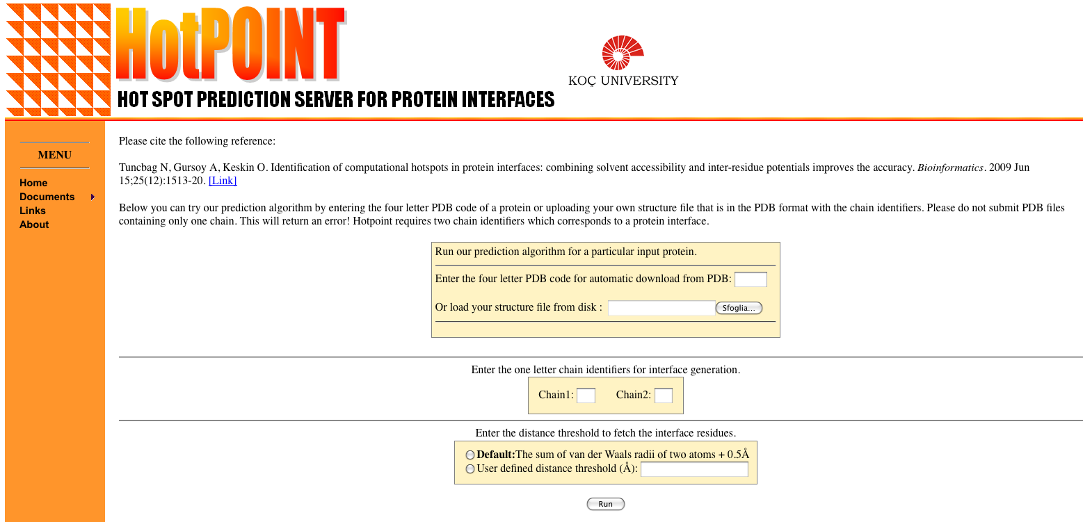
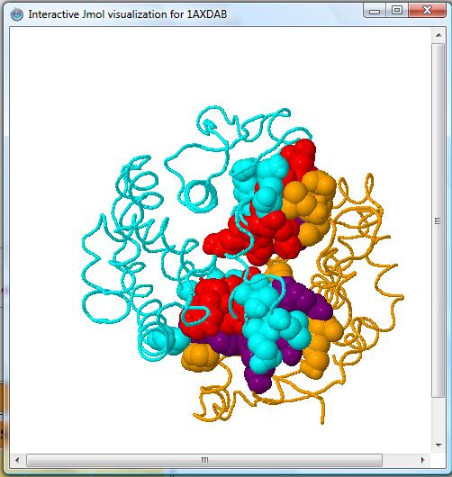
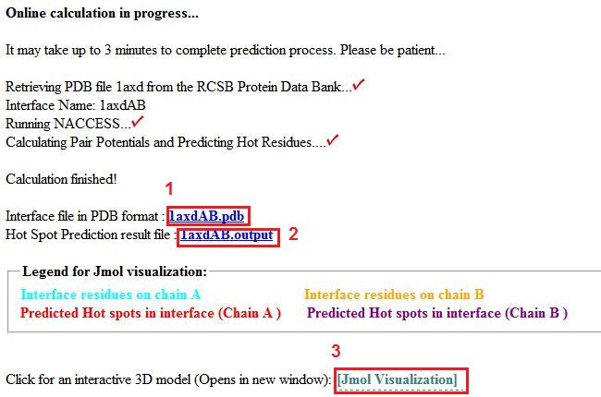
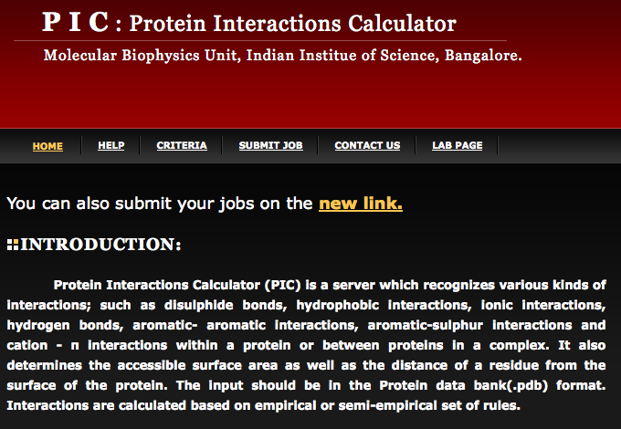
http://prism.ccbb.ku.edu.tr/hotpoint/
HotPOINT calculates solvent accessibilities and total contact potentials. It predicts hot spots at the complex interface
http://crick.mbu.iisc.ernet.in/~PIC/
PIC recognises various kinds of interactions, such as disulphide bonds, hydrophobic interactions, ionic interactions, hydrogen bonds, aromatic- aromatic interactions, aromatic-sulphur interactions and cation-π interactions between proteins in a complex

Slide 63
Prediction of protein-protein interactions
Phylogenetic profiling
Prediction of co-evolved protein pairs based on similar phylogenetic trees
Rosetta stone method
Association methods
Bayesian network modelling
Domain-pair exclusion analysis
Supervised learning problem
Gene fusion
Classification methods
Inference of interactions from homologous structures
Identification of structural patterns (hot spots)
Protein-protein docking
3D

Slide 64
Check-point II
Go to the GDoc
Write a lecture summary, namely all you remember from the lecture.
You have access to the presentation, which means you can go through the slides to better remember and organise your thoughts
Homework: create a GDoc
name-surname-report
Use lecture summaries and further info you will collect from other sources to write the first part of your report
Paste the link to your Gdoc in the shared GDoc

Slide 65
And now…get down to business!

Slide 66
Theories on protein-ligand binding
Lock and key theory (enzyme-substrate)
Induced fit theory (enzyme-substrate)
Monod-Wyman-Changeux (MWC) model or pre-existing equilibrium theory (two different equilibrium conformations)
Population shift theory: proteins shift spontaneously between multiple conformations (substates). The ligand stabilises preferentially one.

